Slide 1
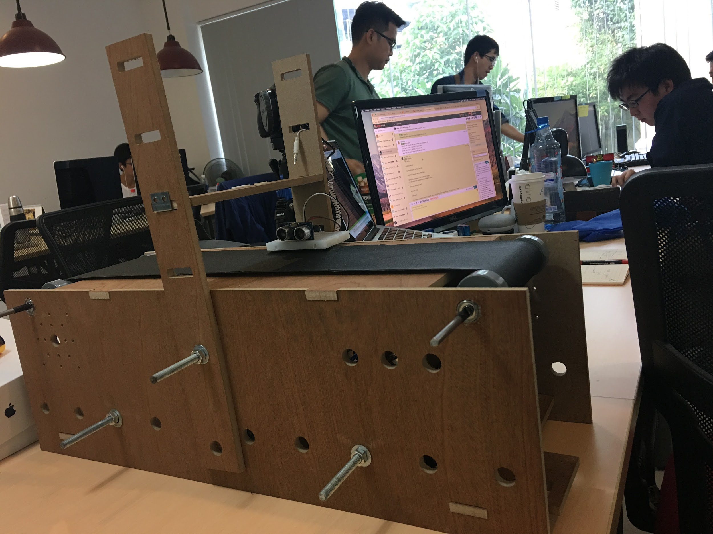
Conveyor Belt
VFA - AI Team

Slide 2
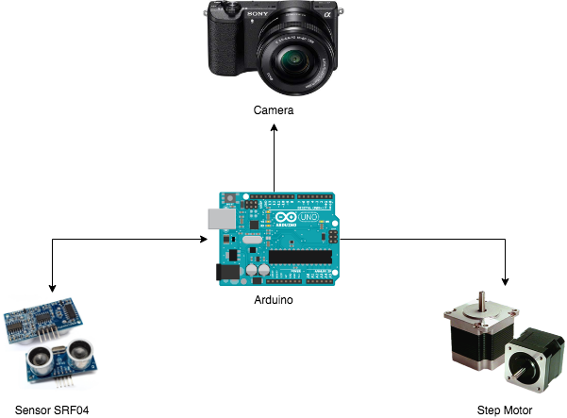
General model
VFA - AI Team

Slide 3
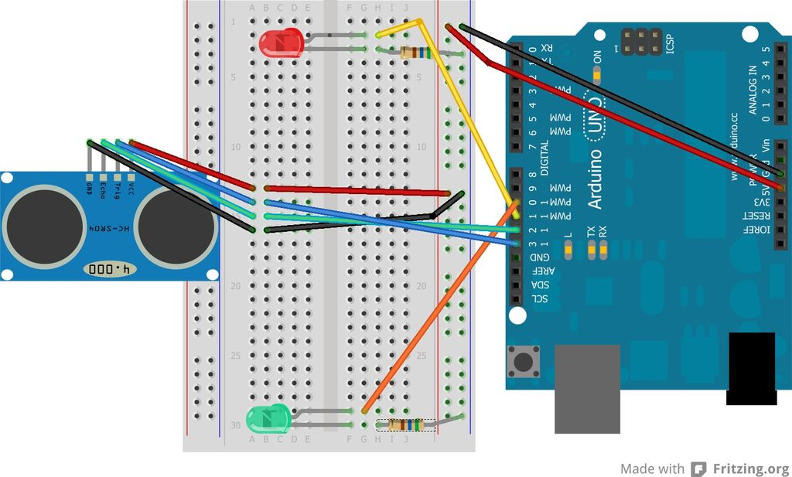
Connecting of Step Motor and Arduino
VFA - AI Team

Slide 4
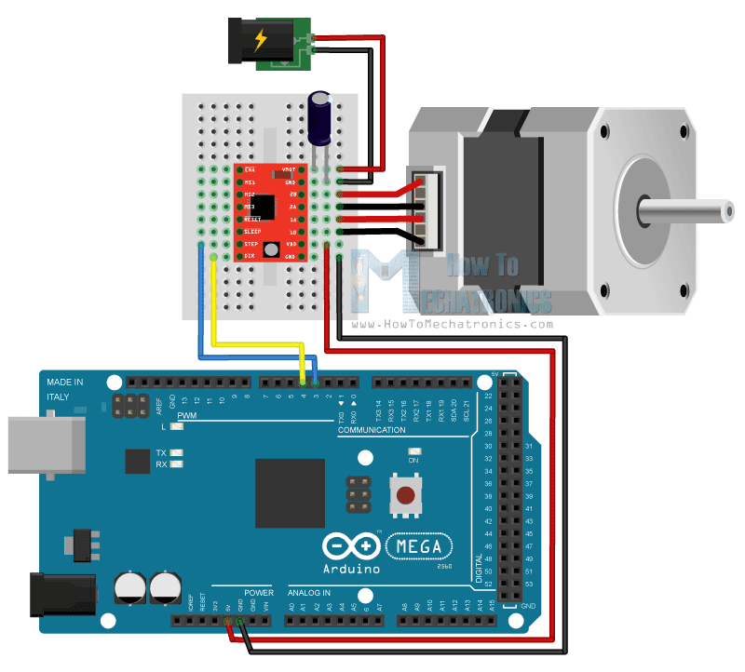
Connecting of sensor SRF04 and Arduino
VFA - AI Team

Slide 5
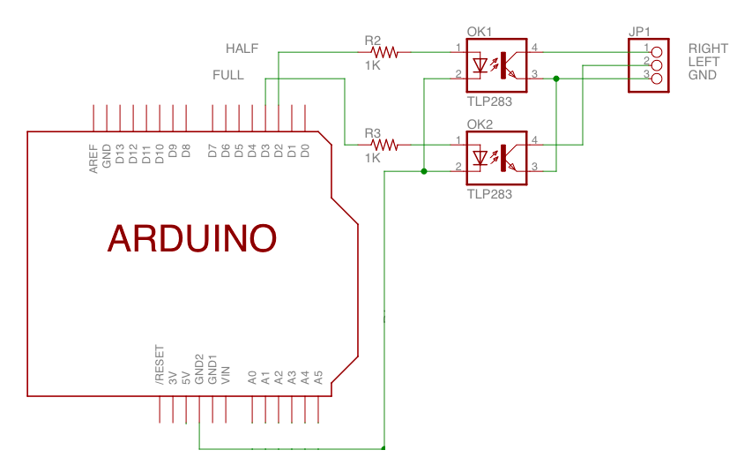
Connecting of DSLR Camera and Arduino
VFA - AI Team

